Slide 1
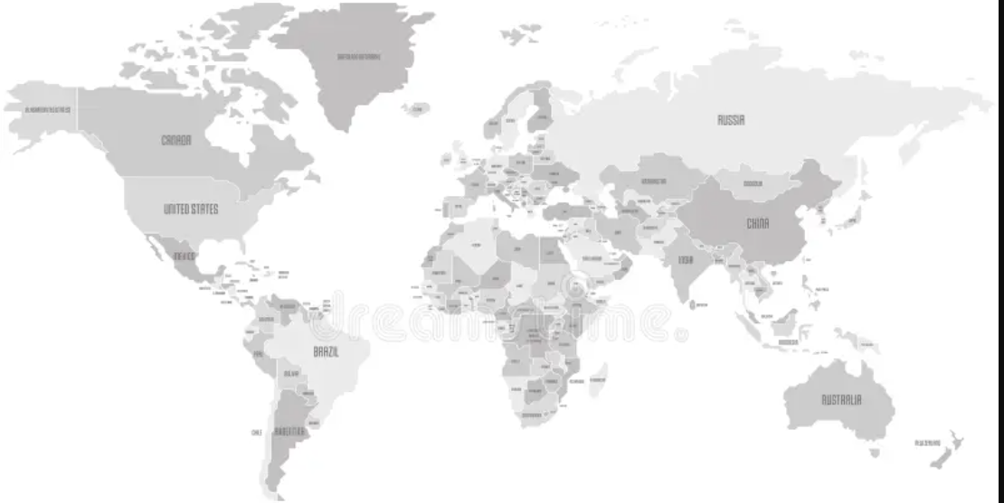
ET SFP –AWARDEES’ COUNTRIES OF ORIGIN
China
Turkey
Sri Lanka
Pakistan
Malaysia
India
Turkey
Germany
U.S.
United Arab
Emirates
Qatar
Saudi Arabia
Jordan
Nigeria
Ghana
South Africa
Botswana
Egypt
Rwanda
Trinidad and Tobago
Chile
Brazil
Colombia
Argentina

